Slide 1
Summer Training
TOPIC –Hotel Management System
Made and Submitted by -
ARUN
Under the guidance of
Mr.vikas kuchhal

Slide 2
DECLARATION
I declare that project entitled “Hotel Management System” is my own work conducted under the supervision of “MR.Vikas Kuchhal”, Department of CSE, BMIET, sonipat.
I further declare that, to the best of my knowledge the project does not contain any work which has been submitted for the award of the degree either in the University or in any other University/Deemed University without proper citations.

Slide 3
Acknowledgment
I wish to express my sincere gratitude to God for his protection, providence, guidance and above all, for sustaining us.
I would like to express our special thanks of gratitude to our professor ‘MR.Vikash Kuchhal. who gave me the golden opportunity to do this wonderful project on the topic ‘Hotel Management System’ , which also helped me in doing a lot of Research and gaining some precious knowledge.
Finally, I wish to express my appreciation to my parents for their love and support.

Slide 4
Outline -
Abstract
Introduction
Administrative Modules
Main Objective
Requirements
Database Tables
Screenshots
Conclusion

Slide 5
Abstract
In my project “Hotel Management System” I have tried to show how the data/information in hotels is managed. This is just an overview of management in hotels. It manages and maintains the records of customers, rooms, employees and drivers in the hotel. The project is aimed to maintain the day-to-day state of admission/vacation of Residents, List of employees, room details etc. Main objective of this project is to provide solution for hotel to manage most there work using computerized process. This software application will help admin to handle customer information, room allocation details, Payment details etc.
The rooms have different categories like single bed, double bed etc. so their charges and records will be maintained accordingly.

Slide 6
Introduction
The project, Hotel Management System is a desktop-based application that allows the hotel manager to handle all hotel activities online. Interactive GUI and the ability to manage various rooms, employees, drivers and customers make this system very flexible and convenient. The hotel manager is a very busy person and does not have the time to sit and manage the entire activities manually on paper. This application gives him the power and flexibility to manage the entire system from a single online system. Hotel management project provides room booking, staff management and other necessary hotel management features. The system allows the manager to post available rooms in the system. The Purpose of the whole process is to ease the daily or regular activities of the Hotel Management into an automatic computerized retrievable process. The daily activities includes the Room activities, Entering details of the new customer check in, To allocate a room as per the customer need and interest, Recording the checkout time and details, Releasing or Empty of room and to record the process in a computer system for future.

Slide 7
The application of the Hotel Management System bears the following functions to use by the Administrator:
Add a new Room
Add an Employee
Add a new Customer
Check room status
Check all employees’ details
Check all Customers’ details
Update room status
Update check status etc.

Slide 8
Objective
Main objective of this project is to provide solution for hotel to manage most there work using computerized process. This software application will help admin to handle customer information, room allocation details, Payment details etc.
Keeping records of admission of customers.
Facilities provided by Hotel are fully utilized in effective and efficient manner.

Slide 9
Existing System:
In the existing manual system a lot of time is spent in communicating the information across different branches. There is a need for an automated system, which has some centralized control over the entire process. Conventional System makes use of huge amounts of paper for recording transactions. All the Hotel records are to be maintained for the details of each customer, Fee details, Room Allocation etc.

Slide 10
Proposed System:
Proposed system is the computerized version of the existing system which provides easy and quick access over the data. Keeping the records of admission of Resident properly so that facilities provided by Hotels are fully utilized in effective and efficient manner.

Slide 11
Disadvantages:
Time consuming
Inaccuracy of data

Slide 12
Advantages:
Less Time consuming
Maintain accuracy

Slide 13
Hardware specifications:
AWT API was introduced in JDK 1.0. Most of the AWT components have become obsolete and should be replaced by newer Swing components.
Swing API, a much more comprehensive set of graphics libraries that enhances the AWT, was introduced as part of Java Foundation Classes (JFC) after the release of JDK 1.1. JFC consists of Swing, Java2D, Accessibility, Internationalization, and Pluggable Look-and-Feel

Slide 14
Software specifications :
Programming Language
Java
Back End Tool
MySql 5.5 command line client
IDE
NetBeans 12.4

Slide 15
Databases Tables:
Customer
Field | Datatype | Constraint
id | Varchar(30) | NN
number | Numeric(30) | PK
name | Varchar(30) | NN
gender | Varchar(30) | NN
country | Varchar(30) | NN
Room number | Numeric(30) | NN
Status | Varchar(30) | NN
Deposit | Numeric(30) | NN

Slide 16
Room
Field | Datatype | Constraint
Room_number | Numeric(30) | PK
availability | Varchar(30) | NN
Clean status | Varchar(30) | NN
Price | Number(30) | NN
BedType | Varchar(30) | NN

Slide 17
Field | DataType | Constraint
Name | Varchar(30) | NN
Age | Numeric(30) | NN
Gender | Varchar(30) | NN
Job | Varchar(30) | NN
Salary | Number(30) | NN
Phone | Number(30) | NN
Adhar | Number(30) | PK
Email | Varchar(30) | NN
Employee

Slide 18
Driver
Field | DataType | Constraint
Name | Varchar(30) | NN
Age | Numeric(30) | NN
Gender | Varchar(30) | NN
Company | Varchar(30) | NN
Brand | Varchar(30) | NN
Available | Varchar(30) | NN
Location | Varchar(30) | NN

Slide 19
Login
Field | DataType | Constraint
Username | Varchar(30) | PK
Password | Varchar(30) | NN

Slide 20
Department
Field | DataType | Constraint
Department | Varchar(30) | PK
Budget | Numeric(30) | NN

Slide 21
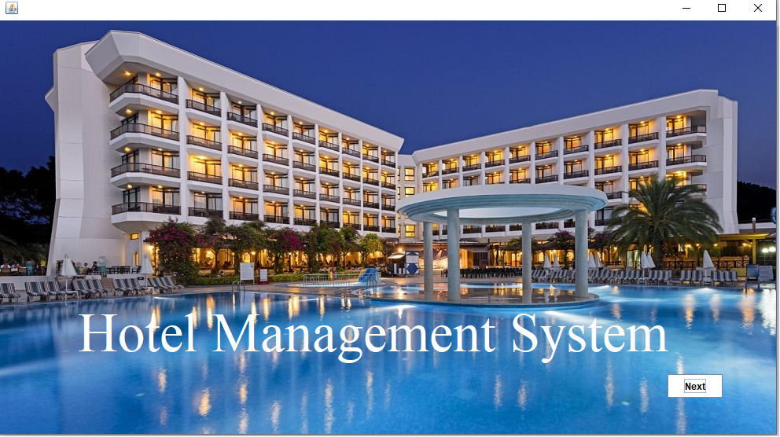
Screenshots Outputs:
Start Screen

Slide 22
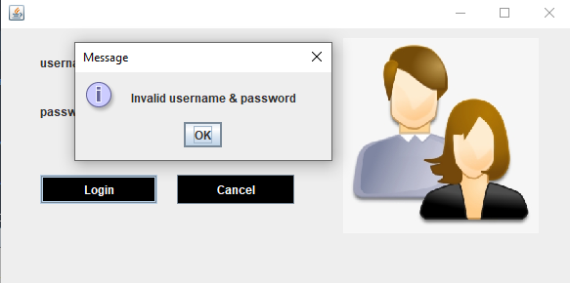
Invalid Username & Password

Slide 23
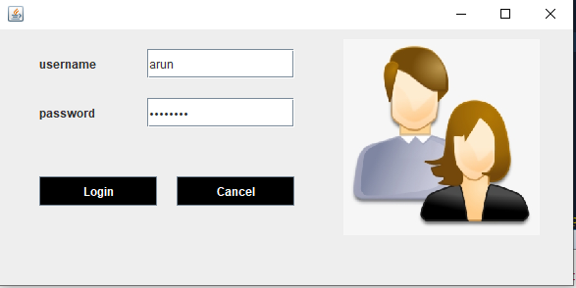
Login Page

Slide 24
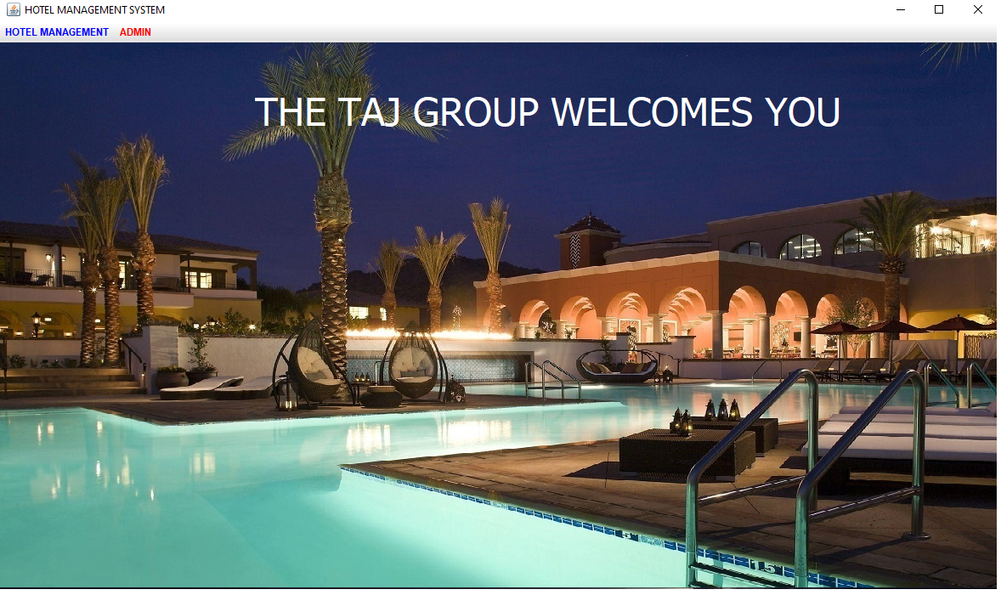
DashBoard Page

Slide 25
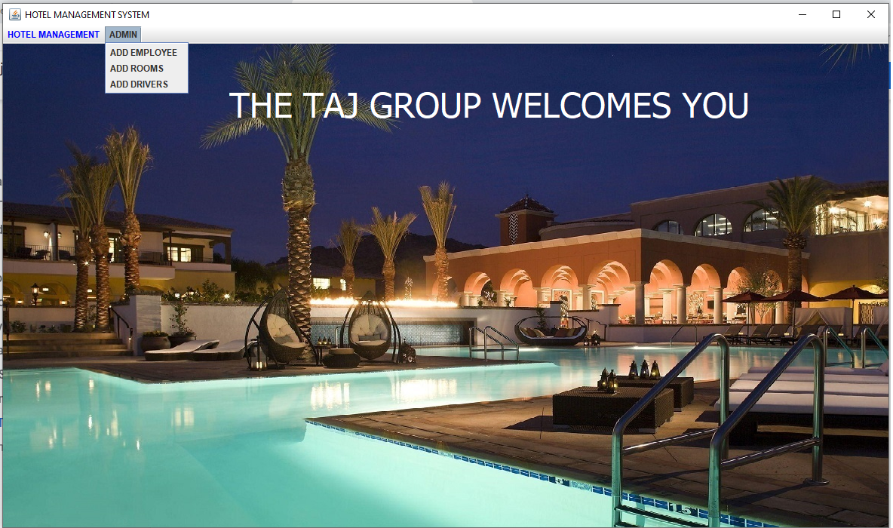
menu

Slide 26
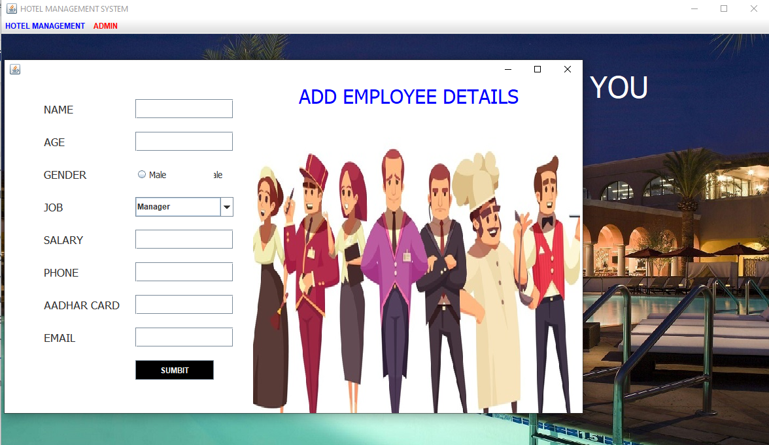
Add Employee

Slide 27
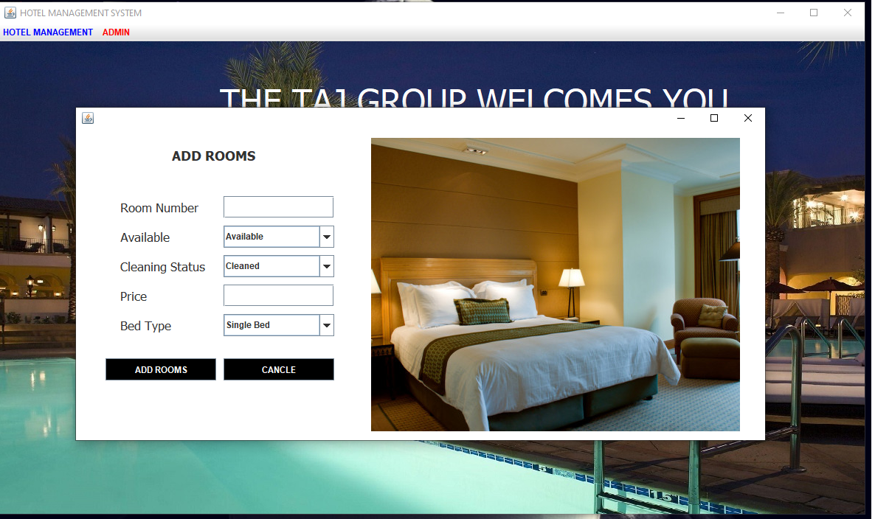
Add Rooms

Slide 28
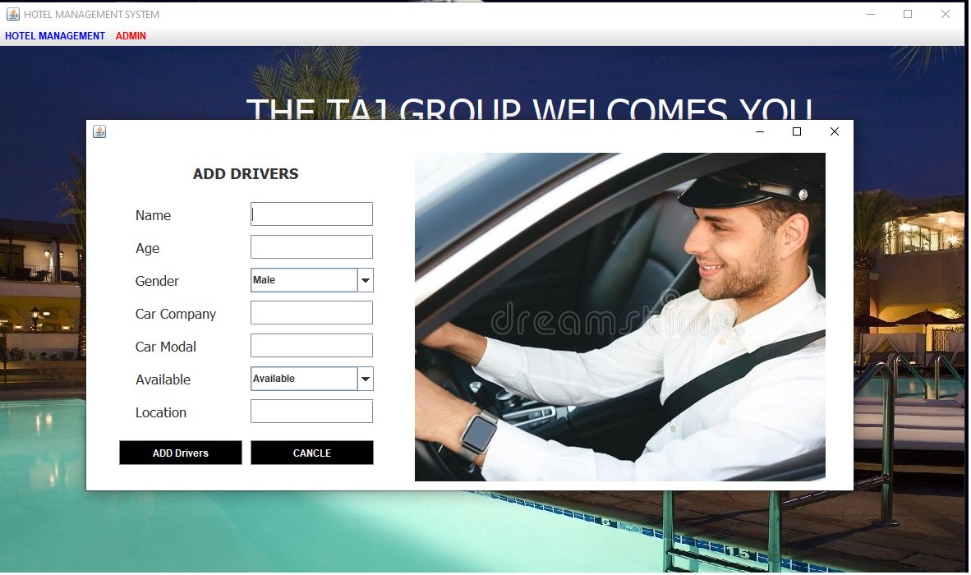
Add Drivers

Slide 29
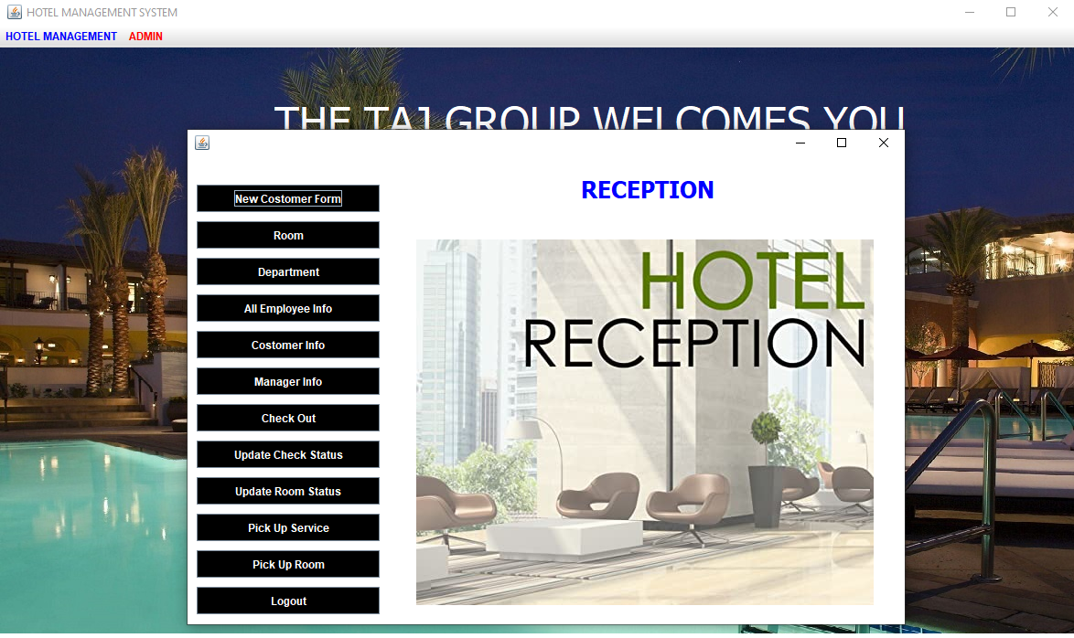
Reception

Slide 30
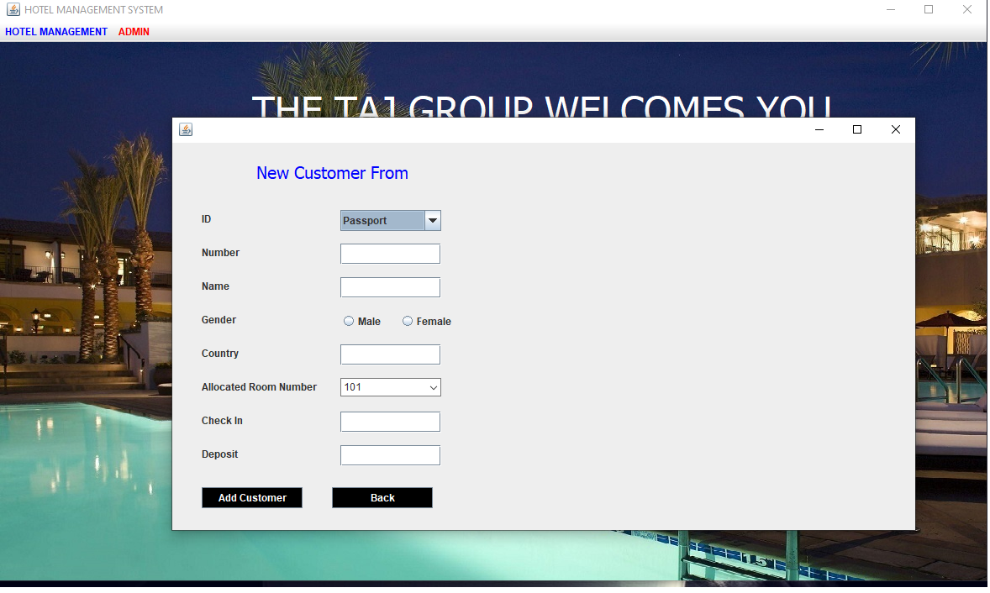
Add new Customer

Slide 31
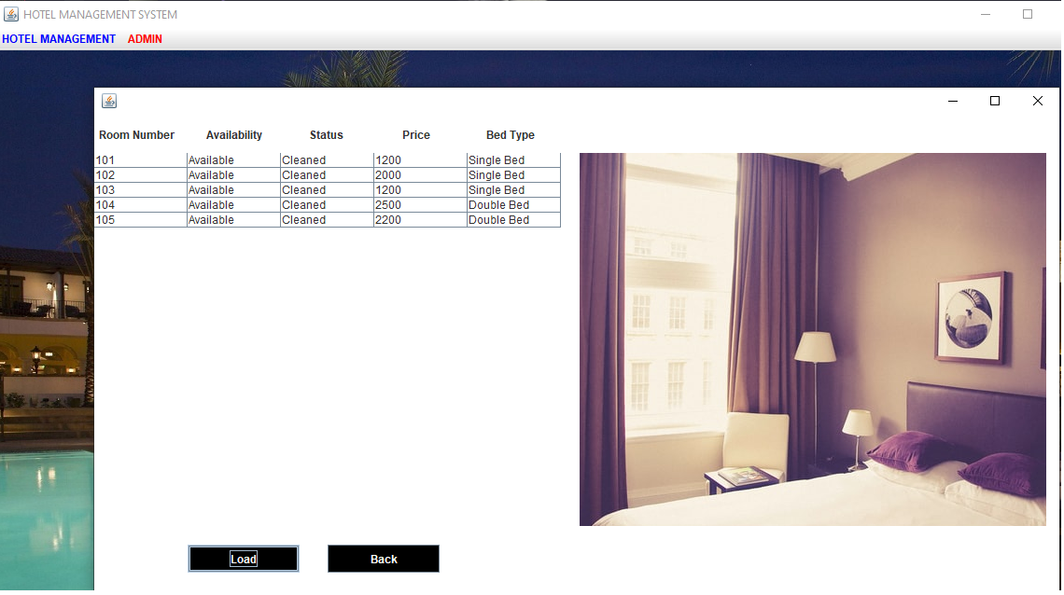
Room Details

Slide 32
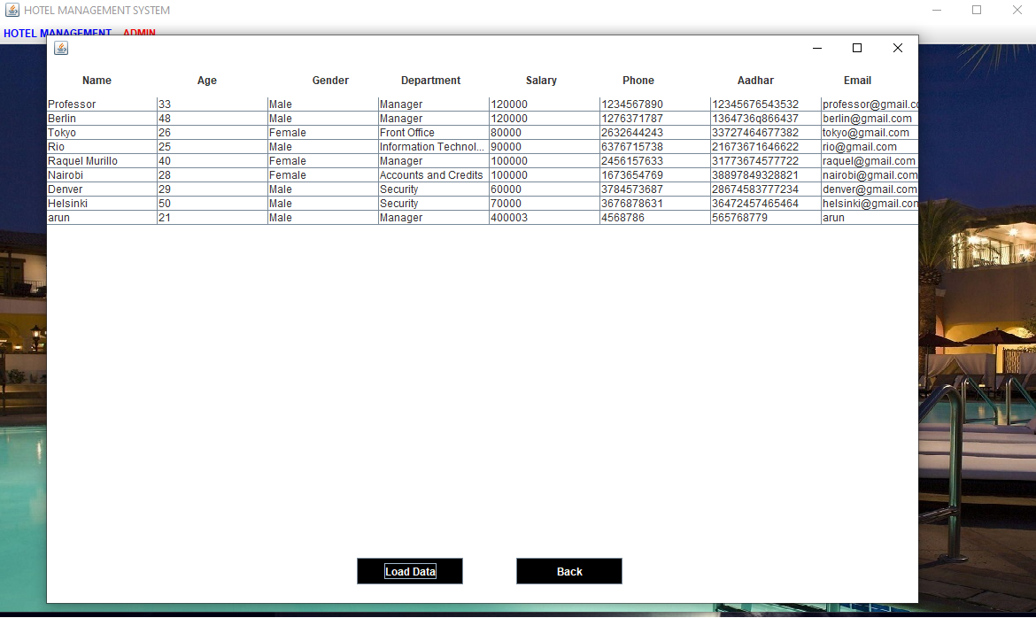
Employee Details

Slide 33
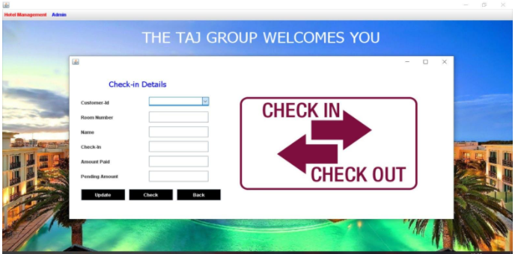
Check In Details

Slide 34
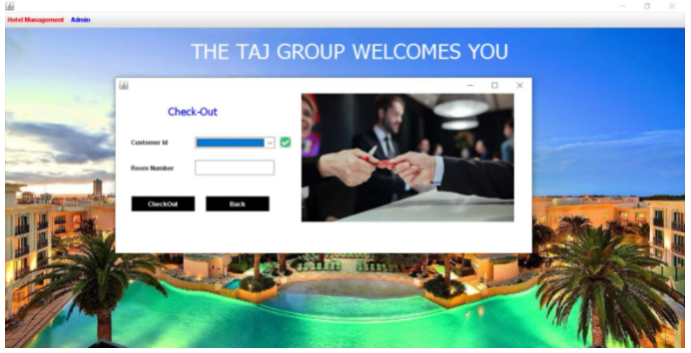
Check out

Slide 35
Conclusion
In this project I have tried my best to make user friendly software. This software can be handled by any person who has little bit of idea of computers. In this software I have tried to meet most of the requirements of the present hotel management system including maintaining details of customers, rooms, employees and drivers. I also keep provision to update the details of customers, rooms and employees. In my effort I have tried to make my software all the more user friendly but there may some features which I would like to include in my continuous attempts.

Slide 36
Thank You!

